Slide 1



Spring Security - Show Login Error
m

Slide 2
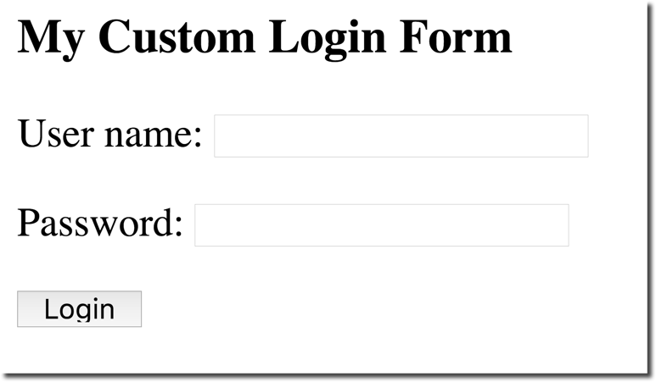

No error message for failed login - What???
No error message???
www.luv2code.com

Slide 3
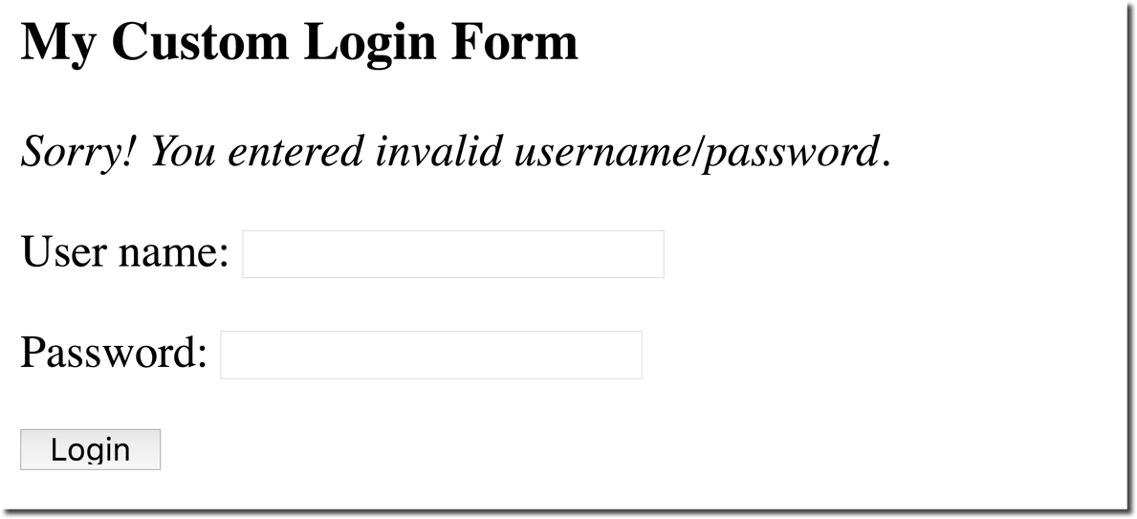


We need an error message … ASAP!!!
We’ll add this support
www.luv2code.com

Slide 4
Failed Login
•
When login fails, by default Spring Security will …
•
Send user back to your login page
•
Append an error parameter: ?error
www.luv2code.com

Slide 5

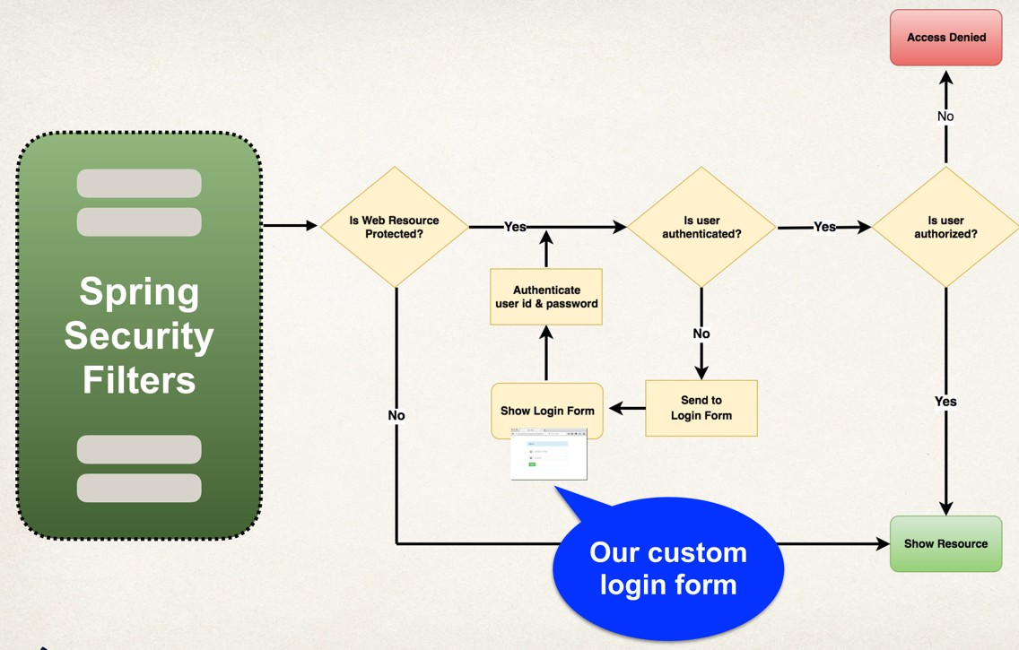
Failed Login
www.luv2code.com

Slide 6
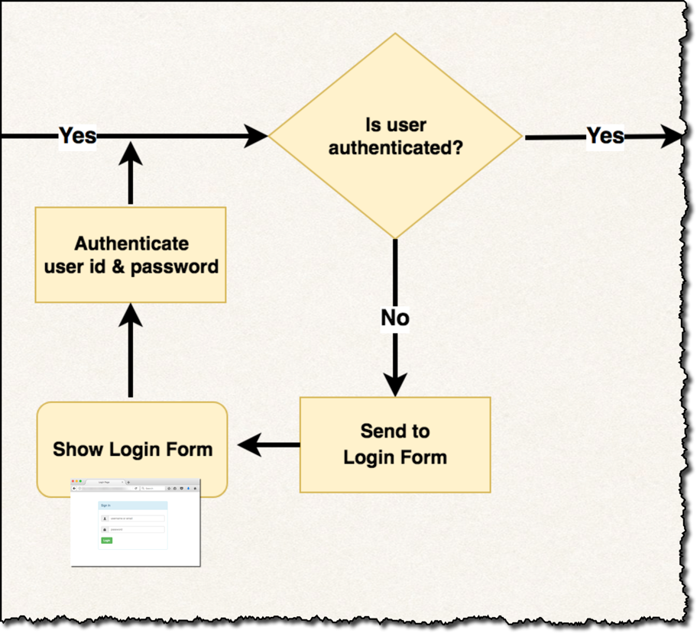

Failed Login
Failed Login
www.luv2code.com

Slide 7

Failed Login
Send back to Login Form
www.luv2code.com

Slide 8



Failed Login
http://localhost:8080/myapp/showMyLoginPage?error
Append param to URL:
error
www.luv2code.com

Slide 9


Development Process
Step-By-Step
Modify custom login form
Check the error parameter
If error parameter exists, show an error message
JSTL can help with this :-)
www.luv2code.com

Slide 10



Step 1: Modify form - check for error
Use JSTL
File: WEB-INF/view/plain-login.jsp
<%@ taglib prefix="c" uri="http://java.sun.com/jsp/jstl/core" %>
…
<form:form action="…" method="…">
<c:if test="${param.error != null}”>
If error param
then show message
<i>Sorry! You entered invalid username/password.</i>
</c:if>
User name: <input type="text" name="username" /> Password: <input type="password" name="password" />
</form:form>
…
www.luv2code.com

Slide 11


Step 1: Modify form - check for error
Use JSTL
File: WEB-INF/view/plain-login.jsp
<%@ taglib prefix="c" uri="http://java.sun.com/jsp/jstl/core" %>
…
<form:form action="…" method="…">
<c:if test="${param.error != null}”>
If error param
then show message
<i>Sorry! You entered invalid username/password.</i>
</c:if>
User name: <input type="text" name="username" /> Password: <input type="password" name="password" />
http://localhost:8080/myapp/showMyLoginPage?error
</form:form>
…
www.luv2code.com

Slide 12
Spring Security - Bootstrap Login Page
m

Slide 13
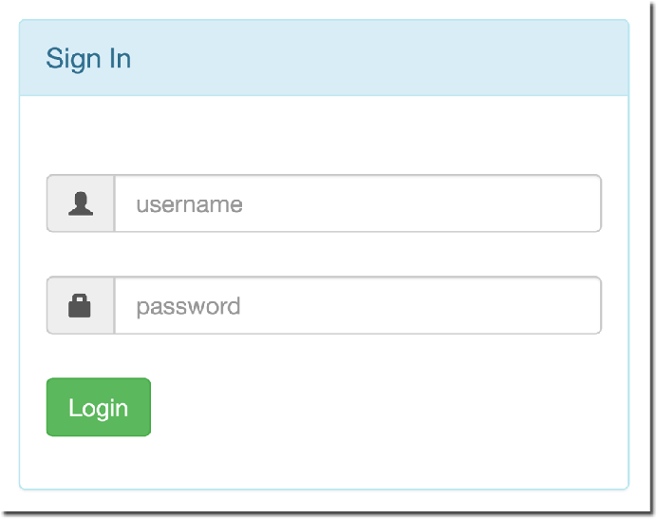
Let’s Make our Login Form Beautiful
Before
After
Bootstrap
www.luv2code.com

Slide 14
Bootstrap
•
Bootstrap is a web framework that includes CSS styles and JavaScript
•
Focused on front-end UI
•
For our project, you do not need any experience with Bootstrap :-)
www.luv2code.com

Slide 15
Our Game Plan
My friend, Alan, has helped us out
He created an HTML login form using Bootstrap
www.luv2code.com

Slide 16
Our Game Plan
My friend, Alan, has helped us out
He created an HTML login form using Bootstrap
•
We’ll modify the form to use Spring Security for our project
www.luv2code.com

Slide 17
Development Process
Step-By-Step
Modify form and add support for Spring MVC form tags
Update form to point to our login processing URL
Verify form fields for username and password
Change our controller to use our new Bootstrap login form
www.luv2code.com

Slide 18
Bootstrap Tutorials and Docs
There are tons of free tutorials online: “bootstrap tutorial”
www.w3schools.com/bootstrap
•
Bootstrap Official Documentation
www.getbootstrap.com/docs
www.luv2code.com

